Slide 1
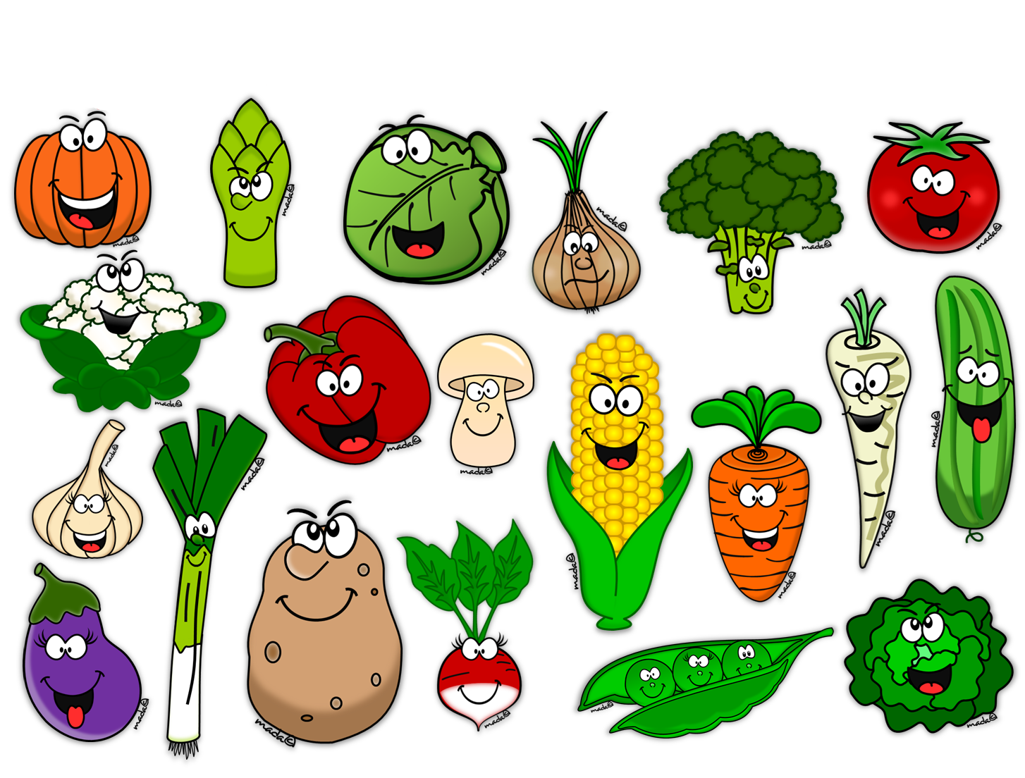
JUURVILJAD

Slide 2
Mis on korvis?
kartul
porgand
sibul
kurk
See on
kurk.
seen

Slide 3
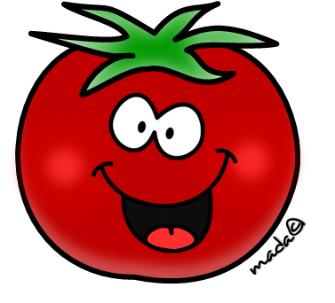
Mis on korvis?
kapsas
kurk
tomat
hernes
See on
tomat.
kartul

Slide 4
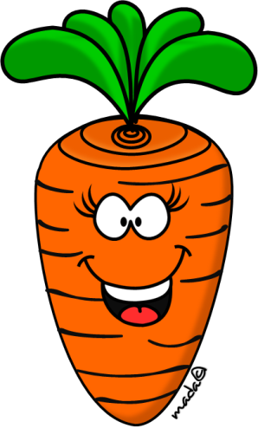
Mis on korvis?
porgand
seen
kapsas
tomat
See on
porgand.
kurk

Slide 5
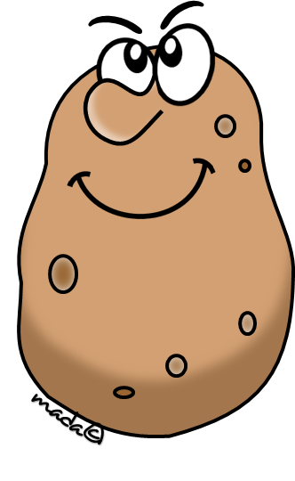
Mis on korvis?
kartul
sibul
porgand
kurk
See on
kartul.
kapsas

Slide 6
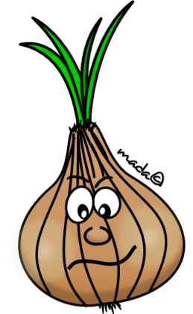
Mis on korvis?
hernes
tomat
kurk
sibul
See on
sibul.
porgand

Slide 7
Mis on korvis?
kartul
sibul
seen
tomat
See on
seen.
redis

Slide 8
Mis on korvis?
kapsas
porgand
kartul
seen
See on
kapsas.
hernes

Slide 9
Mis on korvis?
porgand
tomat
paprika
hernes
See on
hernes.
kurk

